Slide 1
Research Paper Presentation
On
Artificial Intelligence in Business & Marketing
Mandeep Kaur Walia (2210991879)
Shiwali (2210992334)
Shivam Kumar (2210992312)
Shivam Sharma (2210992316)
Supervised By :Ms. Simar Virk
Department of Computer Science and Engineering,
Chitkara University, Punjab

Slide 2
Abstract
Artificial Intelligence is transforming business and marketing operations.
AI improves efficiency, automation, and customer targeting.
However, AI-generated marketing content lacks creativity and emotional depth.
This research compares AI-driven, Human-led, and Hybrid marketing strategies.
The study is based on secondary data and marketing datasets.
Results show Hybrid marketing performs best overall.
2

Slide 3
Introduction
AI is widely used in marketing for:
Content generation
Customer segmentation
Recommendation systems
Marketing automation
AI improves efficiency and reduces marketing costs.
However, over-reliance on AI may reduce creativity and brand uniqueness.
This creates a conflict between efficiency and creativity in marketing.
This research studies the impact of AI on marketing performance and creativity.
3

Slide 4
Research Objectives
To study the role of AI in business and marketing.
To compare AI-driven, Human-led, and Hybrid marketing strategies.
To analyze marketing performance using engagement and conversion metrics.
To study the impact of AI on creativity and brand recall.
To identify the most effective marketing approach.
4

Slide 5
Related Work
Previous studies show AI improves:
Customer targeting
Personalization
Marketing automation
AI recommendation systems increase customer engagement.
NLP tools are used for automated content generation.
However, studies also show AI lacks:
Emotional intelligence
Creativity
Original storytelling
5

Slide 6
Methodology
This research is based on secondary data analysis.
Data sources include:
Research papers
Industry reports
Marketing datasets
A comparative analysis was performed between:
AI-driven marketing
Human-led marketing
Hybrid marketing
Performance metrics analyzed:
Engagement
Conversion
Recall
Creativity
Accuracy
Production Time
6

Slide 7
Datasets Used
The Online Shoppers Purchasing Intention dataset analysis shows an average conversion rate of approximately 15.47%, indicating that customer engagement and interaction metrics significantly influence purchase decisions. Bounce rates and exit rates were found to negatively correlate with conversion, suggesting that higher engagement leads to higher conversion probability. These behavioral insights support the importance of personalized and optimized marketing strategies, which are commonly achieved using AI-driven marketing tools.
https://d.docs.live.net/e5cd7a0fc2f14ddf/Desktop/Downloads/online%5eMshoppers%5eMpurchasing%5eMintention%5eMdataset/online_shoppers_intention.csv
Used to analyze:
Customer engagement
Conversion behavior
Marketing effectiveness
7

Slide 8
Datasets Used
No single dataset compares AI, Human, and Hybrid marketing directly.
Therefore, a Synthesized Dataset was created.
Data compiled from:
McKinsey & Company – The State of AI (2023), Next in Personalization Report (2021)
Deloitte – State of AI in the Enterprise (2022), AI-Powered Marketing Report (2023)
Salesforce – State of Marketing Report (2023), State of Marketing Report (2022)
HubSpot – State of Marketing Report (2023), Marketing Statistics & Trends Report (2022)
Statista – Artificial Intelligence in Marketing – Statistics & Facts (2023), Digital Marketing Performance Statistics (2022)
8

Slide 9
Model Selection
Random Forest shows the best overall performance.
Model | Accuracy
Logistic Regression | 82%
Support Vector Machine | 84%
Decision Tree | 86%
Random Forest | 89%
9

Slide 10
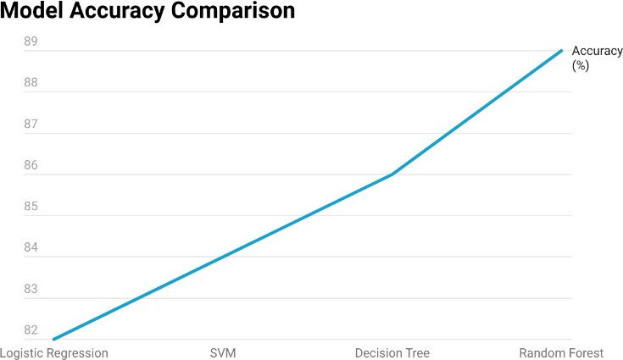
Results
Random Forest shows the best overall performance.
10

Slide 11
Results and Findings
Hybrid shows the best overall performance.
Campaign Type | Avg Time (hrs.) | Engag ement (%) | Conversi on (%) | Recall (%) | Creati vity Score | Accura cy (%)
AI-Driven | 5 | 6.4 | 3.2 | 45 | 5.0 | 85
Human- Led | 12 | 8.0 | 4.4 | 70 | 8.5 | N/A
Hybrid | 8 | 9.1 | 5.5 | 80 | 9.0 | 90
11

Slide 12
Key Findings
AI-driven marketing is the most efficient in terms of time and cost.
AI has high predictive accuracy but lower emotional and creative impact.
Human-led marketing performs better in creativity, engagement, and brand recall.
Hybrid marketing shows the highest overall performance.
Hybrid strategy provides the best balance between efficiency and creativity.
Marketing success depends on both data accuracy and creativity.
12

Slide 13
Conclusion
AI improves efficiency, automation, and data-driven decision making.
Human marketing improves creativity, storytelling, and brand identity.
AI alone cannot replace human creativity in marketing.
Hybrid marketing strategy is the most effective approach.
Future marketing will depend on collaboration between AI and humans.
In conclusion, Artificial Intelligence is transforming business and marketing by improving efficiency, personalization, and analytics. However, marketing also requires creativity, emotional connection, and brand storytelling, which AI cannot fully replicate. Therefore, organizations should adopt a hybrid marketing approach where AI is used for data analysis and automation, and humans focus on creativity and strategy. This combination leads to the most effective marketing performance and represents the future of marketing.
13

Slide 14
Thank You
14

